Slide 1

Title IX Investigations
New guidance – new procedures
Chad Timmons
Director/Shareholder
ctimmons@Abernathy-law.com
Angie Sander
Associate
asander@Abernathy-law.com

Slide 2
Presentation Agenda
Vocabulary
Planning an investigation
Components of an Effective Investigation
Conducting the Interviews
Conducting the Investigation
Completing the investigation report – The Finale

Slide 3

vocabulary
Definitions to keep in mind

Slide 4
Definitions
“Actual knowledge” means notice of sexual harassment or allegations of sexual harassment to a College’s Title IX Coordinator or any official of the college who has authority to institute corrective measures on behalf of the college. Imputation of knowledge based solely on vicarious liability or constructive notice is insufficient to constitute actual knowledge.
This standard is not met when the only official of the college with actual knowledge is the respondent. The mere ability or obligation to report sexual harassment or to inform a student about how to report sexual harassment, or having been trained to do so, does not qualify an individual as one who has authority to institute corrective measures on behalf of the College. “Notice” as used in this paragraph includes, but is not limited to, a report of sexual harassment to the Title IX Coordinator.

Slide 5
Definitions Cont’D.
“Complainant” means an individual who is alleged to be the victim of conduct that could constitute sexual harassment.
“Consent” is not defined by the Title IX regulations, nor do the regulations require Colleges to adopt a particular definition of consent with respect to sexual assault.
“Respondent” means an individual who has been reported to be the perpetrator of conduct that could constitute sexual harassment.

Slide 6
Jurisdiction
Abernathy, Roeder, Boyd & Hullett, P.C.
  Jurisdiction:
  The Decision Makers have jurisdiction over Title IX claims that are within the “Education program or activity” of the College. This includes situations over which the College exercises substantial control.
  Substantial control over activities includes field trips, academic conferences, or other school-sponsored travel. Substantial control also applies to College-owned buildings.

Slide 7
Prohibited conduct
“Sexual harassment” means conduct on the basis of sex that satisfies one or more of the following:
1. Quid Pro Quo. An employee of the College conditioning the provision of an aid, benefit, or service of the College on an individual’s participation in unwelcome sexual conduct;
2. Unwelcome conduct determined by a reasonable person to be so severe, pervasive, and objectively offensive that it effectively denies a person equal access to the College’s education program or activity; or
3. “Sexual assault” as defined in 20 U.S.C. 1092(f)(6)(A)(v), “dating violence” as defined in 34 U.S.C. 12291(a)(10), “domestic violence” as defined in 34 U.S.C. 12291(a)(8), or “stalking” as defined in 34 U.S.C. 12291(a)(30).

Slide 8
Prohibited conduct
“Sexual assault” means an offense classified as a forcible or nonforcible sex offense under the uniform crime reporting system of the Federal Bureau of Investigation.
“Domestic violence” includes felony or misdemeanor crimes of violence committed by a current or former spouse or intimate partner of the victim, by a person with whom the victim shares a child in common, by a person who is cohabitating with or has cohabitated with the victim as a spouse or intimate partner, by a person similarly situated to a spouse of the victim under the domestic or family violence laws of the jurisdiction receiving grant monies, or by any other person against an adult or youth victim who is protected from that person’s acts under the domestic or family violence laws of the jurisdiction.
“Dating violence” means violence committed by a person—
(A) who is or has been in a social relationship of a romantic or intimate nature with the victim; and
(B) where the existence of such a relationship shall be determined based on a consideration of the following factors:
(i)The length of the relationship.
    (ii)The type of relationship.
(iii)The frequency of interaction between the persons involved in the relationship.

Slide 9

Starting / planning an investigation
Where to begin

Slide 10
Steps that should be completed before investigation
Title IX Coordinator spoke to complainant – offered supportive measures and explained the formal complaint process.
Title IX Coordinator sent detailed notice to both complainant and respondent regarding the allegations and next steps.
A formal complaint is received signed by the complainant or the Title IX coordinator.
Possible informal resolution, if appropriate.
  Informal resolution may include stay away agreements or other mutually agreed upon remedies by Complainant and Respondent.
  Must be written agreement / consent to participate by both parties.
  If not successful, may proceed with formal complaint.
  Informal resolution is not available to resolve allegations that an employee sexually harassed
  a student.

Slide 11
Presumption of innocence
All investigations must begin with the presumption that the Respondent is “not responsible” for the alleged conduct until the end of the investigation.
At the end of the investigation, the decision maker will determine whether Respondent is “not responsible” or “responsible” for the alleged conduct.
Crucial to receipt of unbiased, impartial due process for both parties.

Slide 12
Trigger of an investigation
“Formal complaint” means a document filed by a complainant or signed by the Title IX Coordinator alleging sexual harassment against a respondent and requesting that the College investigate the allegation of sexual harassment.
  At the time of filing a formal complaint, a complainant must be participating in or attempting to participate in the education program or activity of the College with which the formal complaint is filed.
  A formal complaint may be filed with the Title IX Coordinator in person, by mail, or by electronic mail, by using the contact information required to be listed for the Title IX Coordinator, and by any additional method designated by the College. As used in this paragraph, the phrase “document filed by a complainant” means a document or electronic submission (such as by electronic mail or through an online portal provided for this purpose by the College) that contains the complainant’s physical or digital signature, or otherwise indicates that the complainant is the person filing the formal complaint.
  Where the Title IX Coordinator signs a formal complaint, the Title IX Coordinator is not a complainant or otherwise a party to a Title IX formal complaint, and must comply with the requirements of the Title IX formal complaint process, including the informal resolution process.

Slide 13
First steps upon receipt of report - Checklist
Pull relevant video or social media posts ASAP
Ensure there are no conflicts of interest or bias issues
Define the parameters of the investigation
Consider the potential objectives of the investigation
Determine the appropriate deadline for completing the investigation
Identify documents to be reviewed and witnesses to be interviewed
Review relevant rules, policies, procedures and instructions
Review records of prior complaints against the accused and records of prior complaints made by the complainant
Decide the order of the interviews
Draft interview questions – focus on consistency
Be mindful of law enforcement’s involvement

Slide 14
When to use an external investigator
The proposed investigator is the subject of the complaint;
The complainant and potential investigator have a close relationship (appearance of a friendship);
The issue is very complex;
The resources are not available internally to complete the investigation in a timely manner; or
It is an investigation of high-level administrators.

Slide 15

Send notification of meeting
Notice must include:
  Date,
  Time,
  Location,
  Participants, and
  Purpose of all hearings, investigative interviews, or other meetings.
Must be provided with sufficient time for the party to prepare to participate (3 – 5 business days or other mutually agreeable timeline).
Request, but not require, the Complainant and Respondent bring all relevant evidence for your consideration.

Slide 16
Evidentiary Standard
More likely than not, or anything above a “fifty-fifty” likelihood of responsibility.
Preponderance of Evidence

Slide 17
Rape shield
  Rape shield protections to complainants.
  All questions and evidence about a complainant’s prior sexual behavior will be deemed irrelevant.
  Exception: It will only be allowed to prove that someone other than the respondent committed the alleged misconduct, or it can be offered to prove consent.

Slide 18
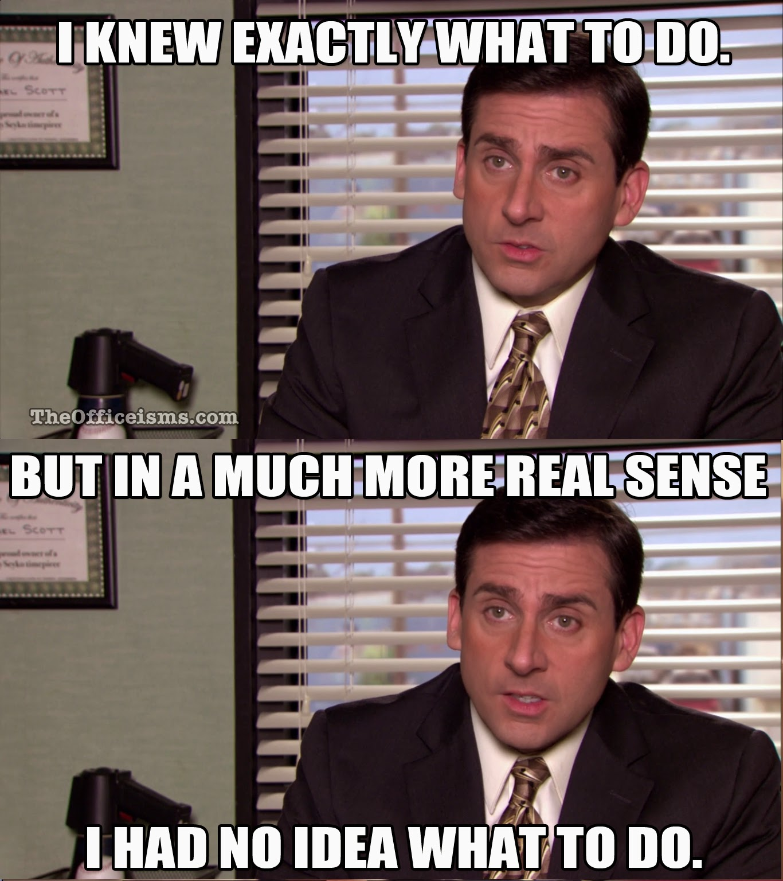
Components of an effective investigation
Key Elements to Consider

Slide 19
Key Elements
Impartiality:
  The investigation should be conducted by a qualified and impartial investigator.
Completeness:
  All relevant claims/issues should be investigated by interviewing all necessary witnesses.
  Each step of the investigation should be well-documented. Witness statements complete, signed and dated.

Slide 20
Key Elements
Timeliness:
  The investigation should begin and end promptly within the timelines established by Board Policy. Any abatements / exceptions must be in writing.
Conclusions:
  The investigator should state conclusions upon which a decision maker can act; these conclusions should be stated objectively.
  Example conclusion: “The investigation demonstrates that Employee X violated the Acceptable Use of Technology Policy on Y date when he . . . . This finding is substantiated by . . . (cite to evidence and explain how it demonstrates a violation of the policy).”
  Avoid “there is no evidence.”

Slide 21
Key Elements
Confidentiality:
  Encourage parties to maintain confidentiality, CANNOT require confidentiality on the part of the Complainant or Respondent.
Communication:
  Interviewees should know when and where to meet. Investigation results should be promptly and properly communicated to the complainant and the respondent.
Remedial Action:
  Appropriate summary and interim remedial action should be taken and documented.
Policy Violation:
  Identify the applicable policy violation(s).

Slide 22

Conducting the interviews
Getting a complete Picture

Slide 23
Who to interview
Who should be interviewed?
  The complainant(s);
  The respondent;
  Third-party reporters;
  Individuals identified by the complainant and respondent; and
  Others with knowledge.
If the complainant or respondent mentions a person, they must be interviewed.

Slide 24
Interview Process
For every interviewee:
  Briefly explain the nature of the investigation – be objective and neutral.
  Explain the College’s obligation to investigate, and its intention to seriously investigate all claims.
  Explain the witness’ obligation to provide complete, true, and accurate information.
  Provide a brief summary of the investigation process.
  Explain the need for confidentiality and privacy (but know that you cannot require it).
  Provide the interviewee with the policy against retaliation.
  Provide information about how the interviewee can follow up on the investigation (ex: who to contact if he/she left something out or has new information).
  Explain when the investigation will conclude, and if/how the interviewee will learn of the results.

Slide 25
Complainant’s interview
When interviewing the complainant:
  Devote extra attention to the anti-retaliation policy.
  Do not promise confidentiality.
  Encourage the complainant to produce a written statement.

Slide 26
Interviewing the respondent
When interviewing the respondent:
  Explain the allegation objectively and carefully.
  Share a copy of the formal complaint.
  Reassure the accused that you would like to hear all of his/her side of the story.
  Ask the hard questions last; stay neutral and nonjudgmental review your understanding of the story; ask one question at a time; ask open-ended questions.

Slide 27
advisor
Each party is allowed to bring an advisor that may or may not be an attorney – cannot be restricted.
Can set parameters for advisor’s role or involvement:
  Observational capacity.
  If the advisor engages in unreasonable, disruptive, harassing or retaliatory behavior, the meeting may be ended early and rescheduled.
  Visitor guidelines are applicable.
Not required to allow more than one advisor.

Slide 28
After the initial interviews
Provide both parties an equal opportunity to inspect and review any evidence obtained as part of the investigation that is directly related to the allegations raised in a formal complaint, including the evidence upon which the College does not intend to rely in reaching a determination regarding responsibility and inculpatory or exculpatory evidence whether obtained from a party or other source, so that each party can meaning- fully respond to the evidence prior to conclusion of the investigation.

Slide 29

Conducting the investigation
Proper Documentation of Investigation materials

Slide 30
Documentation basics
Ensure that all your documents and notes are dated and labeled “privileged and confidential.”
  Record the date, time, and duration of interviews.
Avoid noting thoughts, impressions, or beliefs in notes.
  Take notes as if they are going to be used as an exhibit in the grievance, an EEOC complaint, and/or a lawsuit.
Ensure that all complaints/issues are noted, even if minor.
Keep a record of when you received or provided documents to interviewees.

Slide 31
How to Document?
How do I document?
Email:
  Create a folder for conversations with the individual.
  For very sensitive cases, print emails, with their properties, and store in physical notebook.
  Collect all data – receiver, sender, dates, opened/not opened.

Slide 32
How to Document?
An interview:
  Collect a written statement from the individual.
  Use prepared forms or prepare a form.
  Have the witness write out, sign and date their statement – do not write it for them.

Slide 33
How to Document?
An incident you witness:
  Use only FACTS.
  Avoid conclusory and insufficiently specific statements.
    Example: “Jim was walking to class” (assumes Jim’s destination) v. “Jim was walking in the main hallway between B and C hall.”
    Example: “Carly was angry” v. “Carly spoke in a loud voice. She was crying, and had her arms crossed.”
  Use direct quotations rather than summaries or inferences, even if it involves “foul” language.
  Do not assume guilt.
    Example: “Frank attacked Edward” (assumes Frank was the aggressor) v. “Frank punched Edward in the stomach.”

Slide 34
How to Document?
Something that happens online:
  Capture and print a screen shot. (unless pornography)
  Write down the time and location of access as well as the nature of the content.
  Report to the appropriate authorities.
Something that happens via text:
  Capture and print a screen shot of the text. (unless pornography)
  Have the recipient write a statement regarding the context and interpretation of the text.
  Capture texts ASAP! Deleted / old texts are often unavailable.
What if evidence is highly intimate or embarrassing? Male/female?

Slide 35
Documentation – best practices
Sign and date every document.
Paginate; reference pages when necessary.
  Example: “Employee A did not sign-in at the beginning of the school day on Monday, November 9th (see sign-in sheet, page 6) as required by the directive signed by Employee A on September 22nd (see page 12); Employee A was not out sick on November 9th (see Employee A attendance record, page 15).”
Use official letterhead.
Be factual (avoid opinions, inferences, and conclusions).
Retain records year-to-year.

Slide 36

Evidence – What is relevant?
Permissible and non-permissible Evidence

Slide 37
Relevancy
Abernathy, Roeder, Boyd & Hullett, P.C.
Relevance:
How to decide what is and is not relevant:
If you are choosing to use the preponderance of the evidence standard:
  Does this help me in deciding if a fact is more likely to be true or false?
  Why or why not?
If you are choosing to use the clear & convincing standard:
  Does this help me in deciding if a fact is highly probable to be true?
  Does this help me in deciding if a fact is more or less probable?
  Why or why not?

Slide 38
Relevancy – Rape Shield
Abernathy, Roeder, Boyd & Hullett, P.C.
Non-Admissible Evidence
Any evidence of the complainant’s sexual behavior or predisposition unless:
It is used to prove that someone other than the respondent committed the conduct; or
It concerns specific incidents of the complainant's sexual behavior with respect to the respondent and is offered to prove consent.

Slide 39
Relevancy – Rape Shield
Abernathy, Roeder, Boyd & Hullett, P.C.
Non-Admissible Evidence:
Rape shield protections do not apply to the Respondent.
Evidence of sexual behavior or predisposition may be a part of the investigative report. This may include evidence of a pattern of inappropriate behavior.
This information should be judged for relevancy just like any other evidence.

Slide 40

Relevancy – Treatment Records
Abernathy, Roeder, Boyd & Hullett, P.C.
Treatment Records
An Investigator cannot access, consider, disclose or otherwise use a party’s records that are made or maintained by a physician, psychiatrist, psychologist, or other recognized professional without the party’s voluntary consent.

Slide 41

Relevancy – Hypothetical
Abernathy, Roeder, Boyd & Hullett, P.C.
Hypothetical:
The complainant texted the respondent about having sex the week before the alleged incident.
Is this evidence relevant?
Do you need any additional information to determine if this information is relevant?

Slide 42
Relevancy – Hypothetical
Abernathy, Roeder, Boyd & Hullett, P.C.
Hypothetical:
The witness mentions psychological treatment the complainant sought. Witness did not provide any actual medical records and no signed consent form.
Can witness statement be included in the investigation?
Should you request these records from party or witness?
What if a party or witness provides them to you (without you asking), can you include them in the investigative report?

Slide 43

Relevancy - Hypothetical
Abernathy, Roeder, Boyd & Hullett, P.C.
During an interview for a case of unwelcomed touching, a witness states the respondent had previously tested positive for a sexually transmitted disease.
What do you do with this information?
What if you receive a physical medical record showing that respondent tested positive for a STD? Do you tell anyone?

Slide 44
The finale
Finishing the Investigation and Drafting Findings

Slide 45
Draft Investigation report
Once you have a report, share all evidence used in the report with both the complainant and respondent.
Parties must have at least 10 days to submit a written response, which the investigator will consider prior to completion of the investigative report.
Send to each party and the party's advisor, if any, the investigative report in an electronic format or a hard copy, for their review and written response.
The investigative report must be available to the parties at least 10 days prior to a hearing.

Slide 46
Report Components
Investigation report components:
  Background.
  Application of College’s Guidelines or Policies.
  Key Factual Findings (Summary and Analysis).
  Conclusion and Recommendations.
Send to the decision maker.

Slide 47

Questions?

Slide 48


